Slide 1
Chapter 1 Introduction to Software Project Management

Slide 2
Learning Objectives
Explain what a project is and provide examples of information technology projects
Describe what project management is and discuss key elements of the project management framework
Discuss how project management relates to other disciplines
Understand the history of project management
Describe the project management profession, including recent trends in project management research, certification, and software products

Slide 3
What Is a Project?
A project is “a temporary endeavor undertaken to accomplish a unique product or service”
Attributes of projects
Unique purpose
Outcome can be tangible or intangible
projects are undertaken at all organizational levels
Temporary
Progressive Elaboration
Require resources, often from various areas
Should have a primary sponsor and/or customer
Involve uncertainty

Slide 4
Examples of projects
Developing a new product, service, or result;
Effecting a change in the structure, processes, staffing, or style of an organization;
Developing or acquiring a new or modified information system (hardware or software);
Conducting a research effort whose outcome will be appropriately recorded;
Constructing a building, industrial plant, or infrastructure; or
Implementing, improving, or enhancing existing business processes and procedures

Slide 5
Samples of SW Projects
Many organizations upgrade hardware, software, and networks via projects
Organizations develop new software or enhance existing systems to perform many business functions
Note: “SW projects” refers to projects involving hardware, software, and networks
E.g. -Airlines reservation system
- Vehicle Tracking Using Driver Mobile Gps Tracking.
- Fingerprint Based ATM System. Etc.

Slide 6
What is a project team ?
A project team includes people, who might not usually work together and could belong to different organizations and across multiple geographies that come together to accomplish the project.
Project teams are also temporary – once the project is completed the team will disperse.
The project team might include people who don’t usually work together but they come together only to accomplish the project
Resources may come from different organizations

Slide 7
The Relationships among Portfolios, Programs, and Projects
Portfolio refers to a collection of projects, programs, sub-portfolios, and operations managed as a group to achieve strategic objectives
Programs are grouped within a portfolio and are comprised of subprograms, projects, or other work that are managed in a coordinated fashion in support of the portfolio

Slide 8
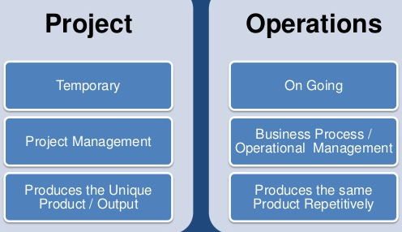
Project Vs Operation
Similarity:
Both are performed by people,
Both are planned, executed and controlled &
Both have resource limitation.
Differences
Projects are unique and temporary (definitive beginning and ending), while operations are ongoing and permanent with repetitive output.
Projects have a fixed budget; on the other hand, operations have to earn a profit in order to run the business.
Projects are executed to start a new business objective and terminated when it is achieved, while operational work does not produce anything new and it is ongoing.
Projects create a unique product, service, or result; Operations produce the same product, aim to earn a profit, and keep the system running.

Slide 9
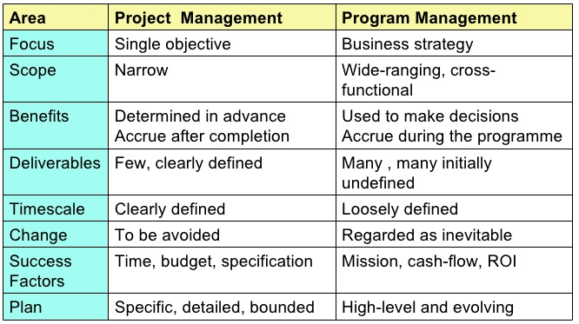
Projects Vs Programs

Slide 10
What is Project Management?
Project management is “the application of knowledge, skills, tools, and techniques to project activities in order to meet project requirements” (Project Management Body of Knowledge (PMBOK® Guide), 2000, p. 6)
The Project Management Institute (PMI) is an international professional society. Their web site is www.pmi.org.
Business leaders understand that project management is a function within the organization and hire individuals are specifically trained in project management to handle organizations project management needs.

Slide 11
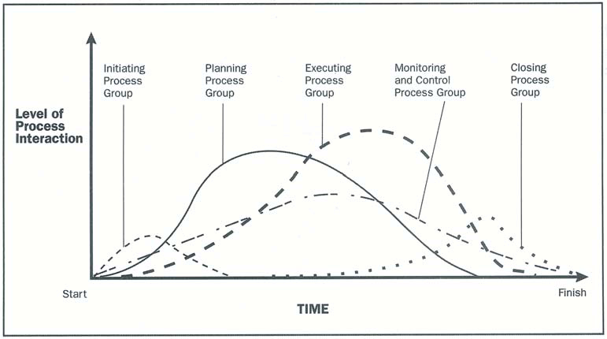
Process Groups of Project Management

Slide 12
Managing a project typically includes:
Identifying requirements
Addressing the various needs, concerns, and expectations of the stakeholders in planning and executing the project;
Setting up, maintaining, and carrying out communications among stakeholders that are active, effective, collaborative in nature;
Managing stakeholders towards meeting project requirements and creating project deliverables;
Balancing the competing project constraints, which include, but are not limited to: Scope, Quality, Schedule, Budget, Resources, and Risks.

Slide 13
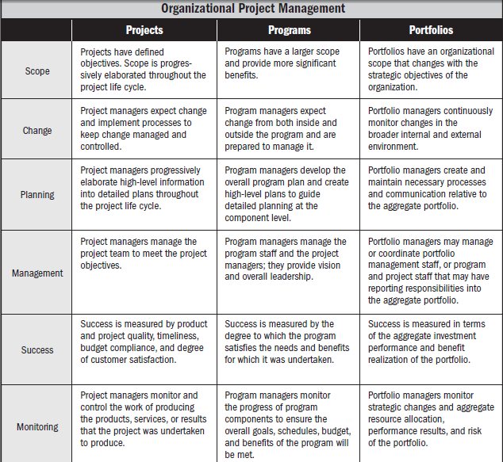

Slide 14
Role of the Project Manager
The role of a project manager is distinct from a functional manager or operations manager.
Typically the functional manager is focused on providing management oversight for a functional or a business unit, and operations managers are responsible for ensuring that business operations are efficient.
Depending on the organizational structure, a project manager may report to a functional manager. In other cases, a project manager may be one of several project managers who report to a program or portfolio manager who is ultimately responsible for enterprise-wide projects
project managers have the responsibility to satisfy the needs: task needs, team needs, and individual needs

Slide 15
Fifteen Project Management Job Functions*
Define scope of project
Identify stakeholders, decision-makers, and escalation procedures
Develop detailed task list (work breakdown structures)
Estimate time requirements
Develop initial project management flow chart
Identify required resources and budget
Evaluate project requirements
Identify and evaluate risks
Prepare contingency plan
Identify interdependencies
Identify and track critical milestones
Participate in project phase review
Secure needed resources
Manage the change control process
Report project status

Slide 16
project manager possess the following competencies:
Knowledge—Refers to what the project manager knows about project management.
Performance—Refers to what the project manager is able to do or accomplish while applying his or her project management knowledge.
Personal—Refers to how the project manager behaves when performing the project or related activity. Personal effectiveness encompasses attitudes, core personality characteristics, and leadership, which provides the ability to guide the project team while achieving project objectives and balancing the project constraints.

Slide 17
Suggested Skills for Project Managers
Project managers need a wide variety of skills
They should be comfortable with change, understand the organizations they work in and with, and be able to lead teams to accomplish project goals
Project managers need both “hard” and “soft” skills.
Hard skills include product knowledge and knowing how to use various project management tools and techniques, and
Soft skills include being able to work with various types of people

Slide 18
Suggested Skills for Project Managers
Communication skills: listening, persuading
Organizational skills: planning, goal-setting, analyzing
Team Building skills: empathy, motivation
Leadership skills: set examples, be energetic, have vision (big picture), delegate, be positive
Coping skills: flexibility, creativity, patience, persistence
Technological skills: experience, project knowledge
• Interpersonal skills of project Manger
Leadership,
Team building,
Motivation,
Communication,
Influencing,
Decision making,
Political and cultural awareness,
Negotiation,
Trust building,
Conflict management, and
Coaching.

Slide 19
Most Significant Characteristics of Effective and Ineffective Project Managers
Effective Project Managers Ineffective Project Managers
Lead by example
Are visionaries
Are technically competent
Are decisive
Are good communicators
Are good motivators
Stand up to upper management when necessary
Support team members
Encourage new ideas
Set bad examples
Are not self-assured
Lack technical expertise
Are poor communicators
Are poor motivators

Slide 20
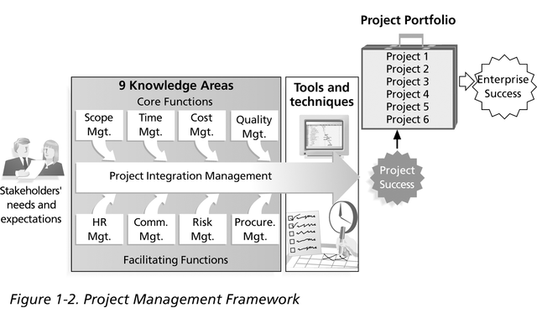
Project Management Framework

Slide 21
Nine Project Management Knowledge Areas
Knowledge areas describe the key competencies that project managers must develop
4 core knowledge areas lead to specific project objectives (scope, time, cost, and quality)
4 facilitating knowledge areas are the means through which the project objectives are achieved (human resources, communication, risk, and procurement management)
1 knowledge area (project integration management) affects and is affected by all of the other knowledge areas

Slide 22
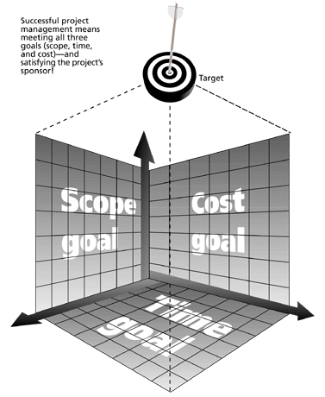
The Triple Constraint
Every project is constrained in different ways by its
Scope goals: What is the project trying to accomplish?
Time goals: How long should it take to complete?
Cost goals: What should it cost?
It is the project manager’s duty to balance these three often competing goals

Slide 23
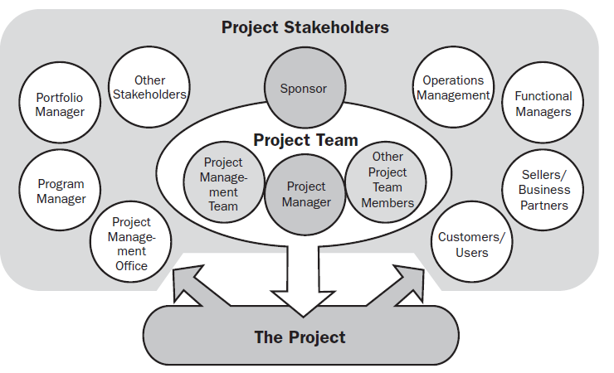
Project Stakeholders
Stakeholders are the people involved in or affected by project activities

Slide 24
Project Management Tools and Techniques
Project management tools and techniques assist project managers and their teams in various aspects of project management
Some specific ones include
Project Charter, scope statement, and WBS (work breakdown structure) (scope)
Gantt charts, network diagrams, critical path analysis, critical chain scheduling (time)
Cost estimates and earned value management (cost)

Slide 25
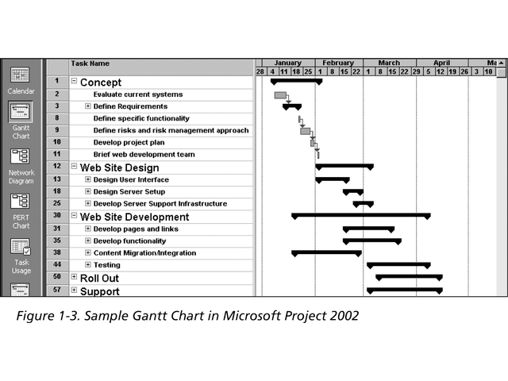
Sample Gantt Chart
The WBS is on the left, and each task’s start and finish date are shown on the right using a calendar timescale. Early Gantt Charts, first used in 1917, were drawn by hand.

Slide 26
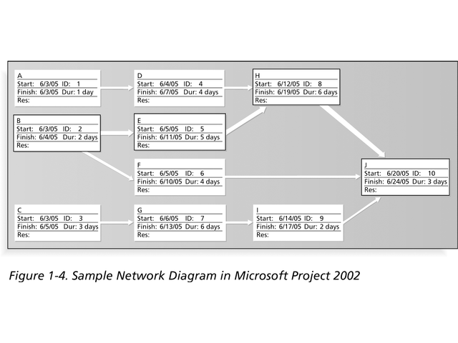
Sample Network Diagram
Each box is a project task from the WBS. Arrows show dependencies between tasks. The bolded tasks are on the critical path. If any tasks on the critical path take longer than planned, the whole project will slip unless something is done. Network diagrams were first used in 1958 on the Navy Polaris project, before project management software was available.

Slide 27
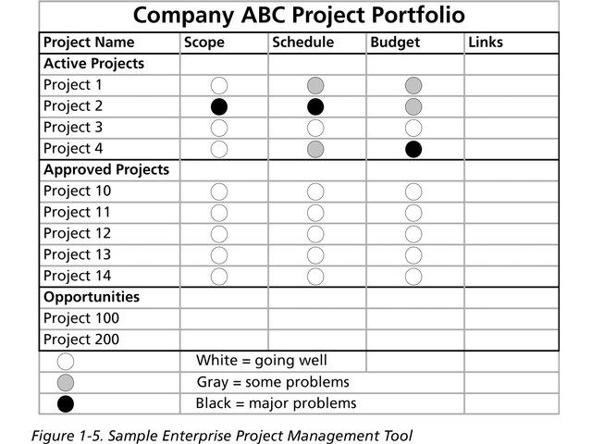
Sample Enterprise Project Management Tool
In recent years, organizations have been taking advantage of software to help manage their projects throughout the enterprise.

Slide 28
Project Management Software
By now there are hundreds of different products to assist in performing project management
Three main categories of tools exist:
Low-end tools: Handle single or smaller projects well, cost under $200 per user
Midrange tools: Handle multiple projects and users, cost $200-500 per user, Project 2000 most popular
High-end tools: Also called enterprise project management software, often licensed on a per-user basis
Project 2013 now includes a separate version for enterprise project management

Slide 29
How Project Management Relates to Other Disciplines
Much of the knowledge needed to manage projects is unique to the discipline of project management
Project mangers must also have knowledge and experience in:
General management
The application area of the project

Slide 30
The Project Management Profession
The job of SW Project Manager is in the list of the top ten most in demand IT skills
Professional societies like the Project Management Institute (PMI) have grown tremendously
Project management research and certification programs continue to grow

Slide 31
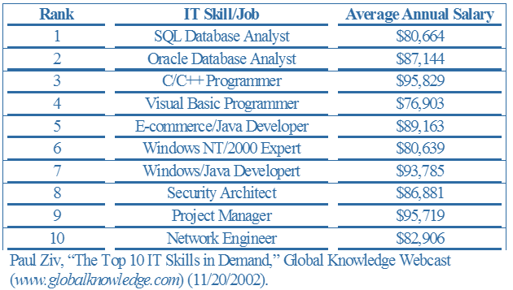
Top Ten Most in Demand IT Skills

Slide 32
You Can Apply Project Management to Many Areas
Project management applies to work as well as personal projects
Project management applies to many different disciplines (SWEng, IT, construction, finance, sports, event planning, etc.)
Project management skills can help in everyday life

Slide 33
End of chapter-1

